Slide 2
Independent
“1) not subject to control by others : self-governing. (2) : not affiliated with a larger controlling unit.”

Slide 3
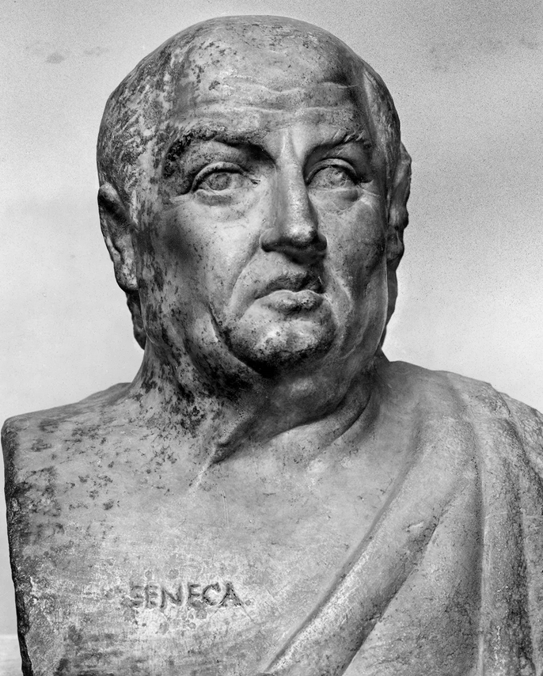
Seneca, Roman Statesman – 65 A.D.
"There is none so great but he may both need the help and service, and stand in fear of power and unkindness, even of the meanest mortals."

Slide 4
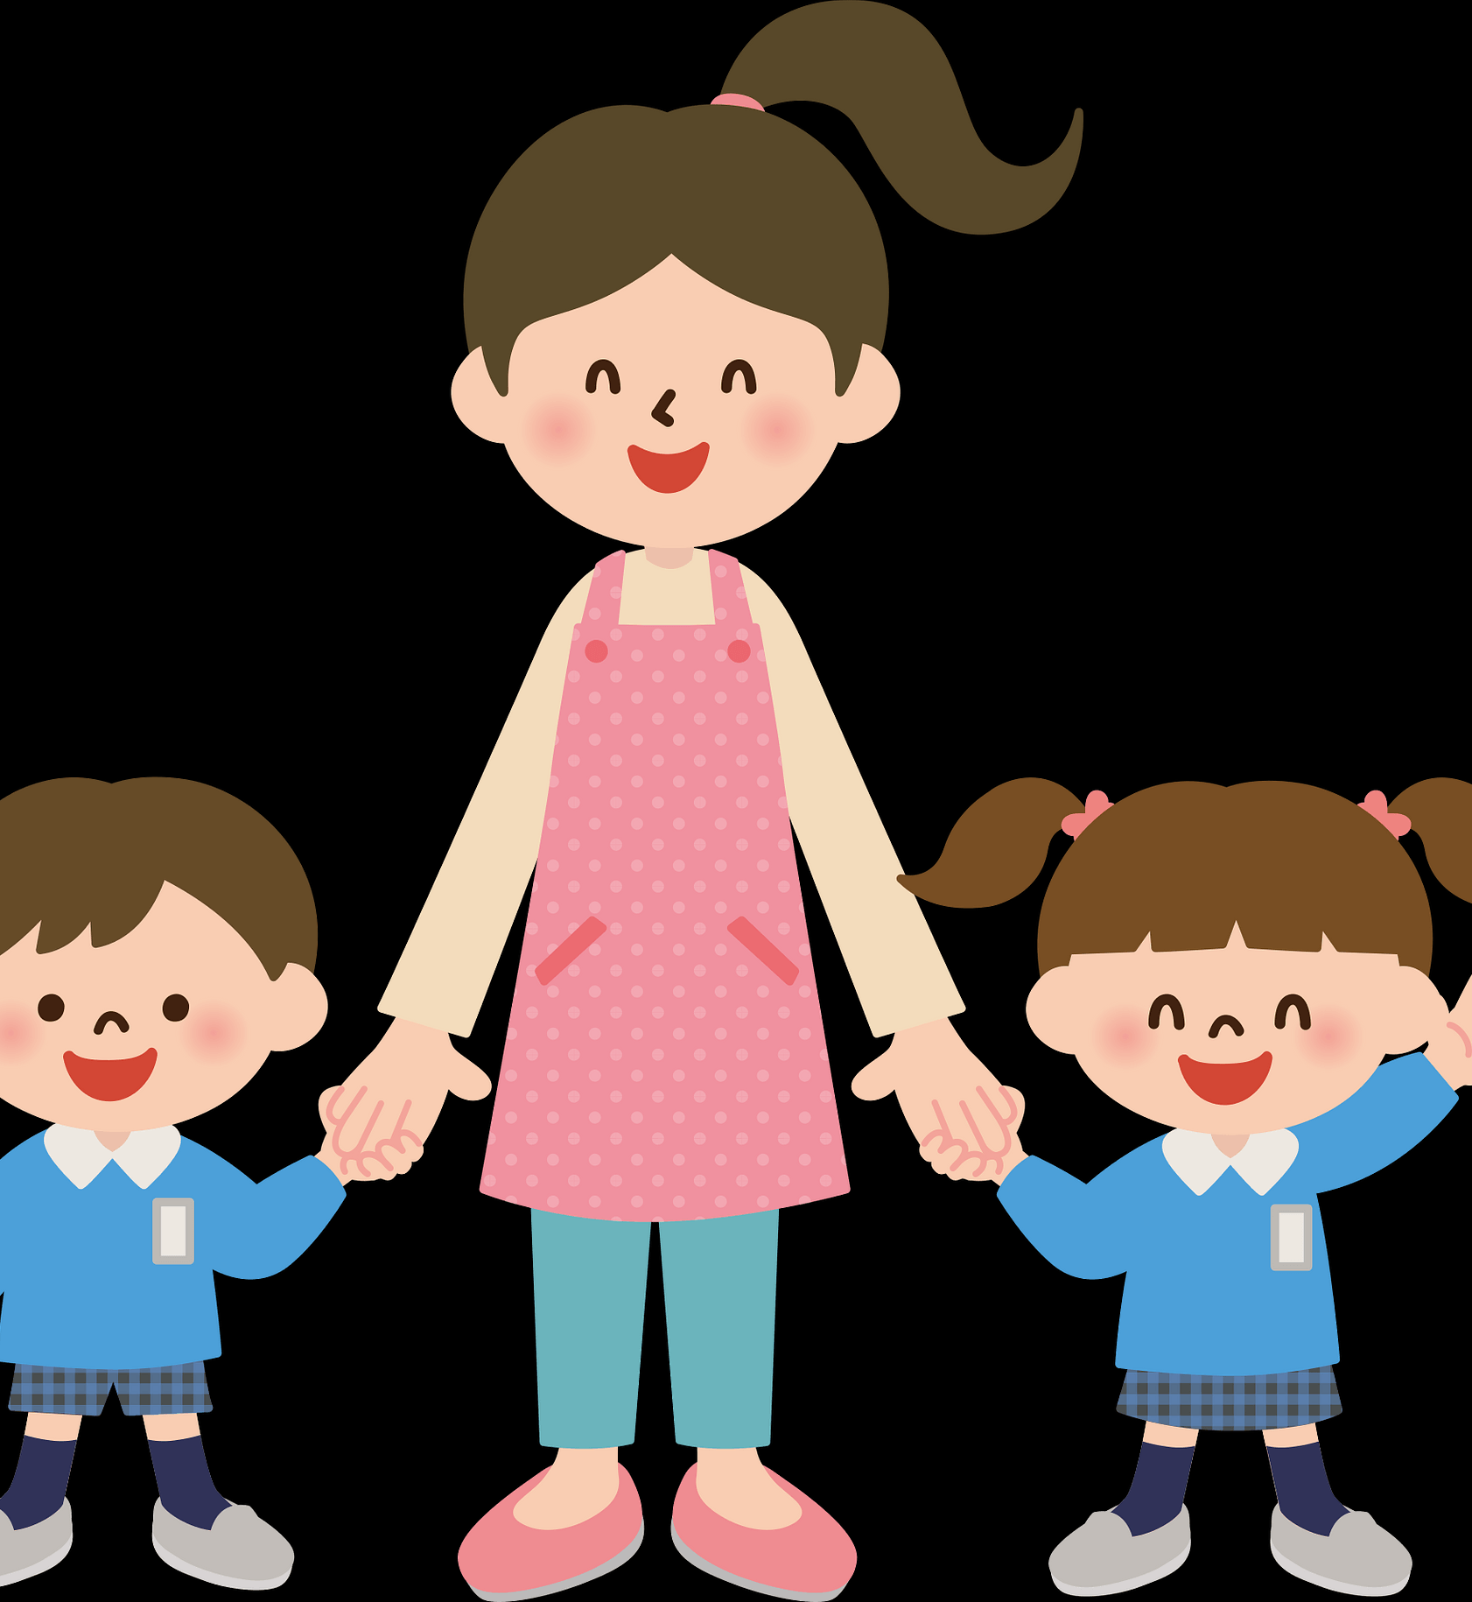
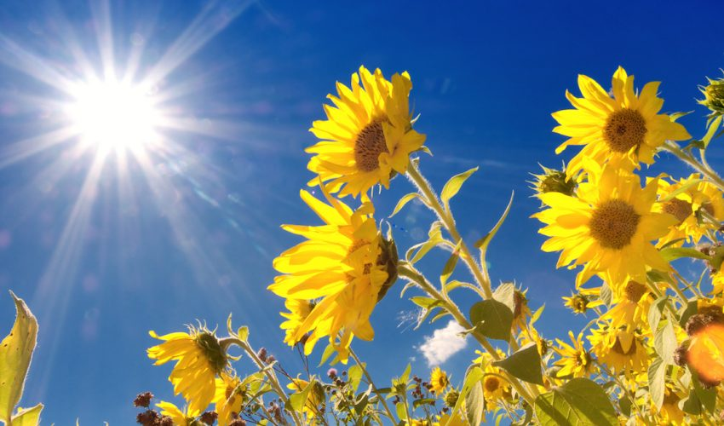
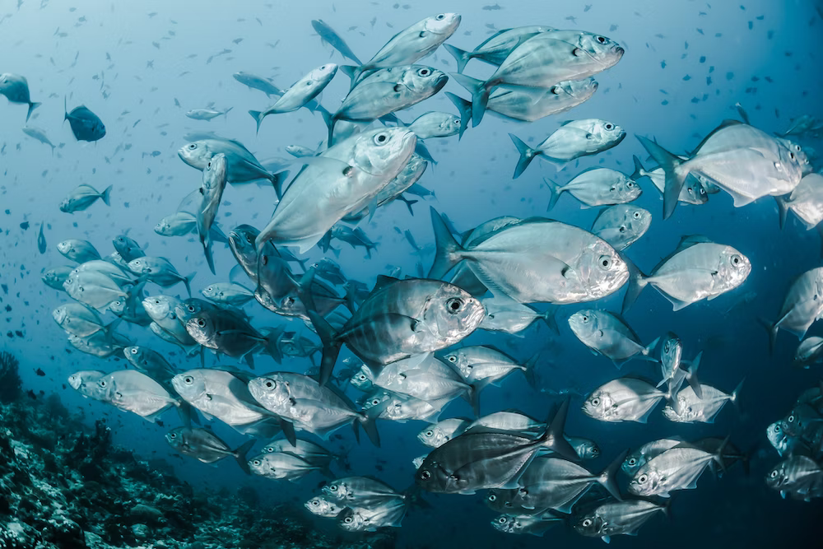
Topic one
Kids dependent on Mothers
Plants depend on sunlight
Subtitle
Fish & other living beings
Depend on Water

Slide 5
Dependency
“No need for a Savior!”
“Self-sufficient!”
“No such thing as DEPENDENCY in their vocabulary!”

Slide 6
Why Is It That We Are Dependent?
God Made Us That Way!
HE is the CREATOR and we are the CREATURE!
We All Have Fears!
All need HELP!
Lack of Knowledge!
We just don’t KNOW about them!
Lack of Confidence in things we DO KNOW!
We are INSECURE and DEPENDENT on OTHERS!
Sooner or later, find out we have NEEDS that we CAN’T SUPPLY for OURSELVES!
Only OTHERS can do it FOR US!

Slide 7
Improper Dependencies
PERSONALITY – “I can win them over.”
WILL POWER – “I practice positive thinking.”
CHARM – “They can’t say no to ME!”
INTELLECTUAL ATTAINMENT – “I have all of the answers.”
INFLUENCE – “I know all of the right people.”
AUTHORITY – “I am in charge!”
SHREWDNESS – “I will figure it out for myself.”
TRICKERY – I will out smart them!”
MONEY – “I will buy my way.”
ABILITY – “I will just do it myself.”

Slide 8
Improper Dependencies
PERSONALITY – “I can win them over.”
WILL POWER – “I practice positive thinking.”
CHARM – “They can’t say no to ME!”
INTELLECTUAL ATTAINMENT – “I have all of the answers.”
INFLUENCE – “I know all of the right people.”
AUTHORITY – “I am in charge!”
SHREWDNESS – “I will figure it out for myself.”
TRICKERY – I will out smart them!”
MONEY – “I will buy my way.”
ABILITY – “I will just do it myself.”
“I”

Slide 9
Proper Dependency
ALWAYS DEPEND ON GOD! Jeremiah 10:23
2 Corinthians 3:5 “sufficiency is from GOD!”
HE and HE Alone has the POWER to supply our NEEDS!
ON GOD’S GRACE – Ephesians 2:4-9
Luke 17:10 “'We are unprofitable servants. We have done what was our duty to do.'"
STILL must depend on God's GRACE to save us through faith!
ON GOD’S WORD- John 17:17 God’s WORD is TRUTH!
John 8:32 KNOW the truth and the TRUTH {the Word of God} shall set us FREE!
Proverbs 3:5 "TRUST IN THE LORD WITH ALL YOUR HEART, AND LEAN NOT ON YOUR OWN UNDERSTANDING."
2 Timothy 3:16,17

Slide 10
Proper Dependency
WITHIN THE BODY OF CHRIST – 1 Corinthians 12:12-26
Being a Disciple of Jesus Christ, is NOT a "SOLO" effort !
ON JESUS – Matthew 28:18-20 He promised to continue to be with all those who were teaching and practicing His will!
1 Timothy 2:5 – Our ONE MEDIATOR!
1 John 1:7 – Blood washes away our sins!
We are DEPENDENT on HIM!
COMMUNICATION – Hebrews 10:25
Upon WHOM or WHAT are YOU DEPENDING TODAY?
Is it PROPER or do you have “I” trouble?

